Slide 1

Contributing to
OpenStreetMap

Slide 2
Contributing to OSM
Creating an account
A few rules
The dataflow through the ecosystem
The datamodel
  Points
  Lines
  Surfaces
  Searching tags on the wiki

Slide 3

A few rules

Slide 4
OSM uses the
Open Database License (ODbL)
All data can be used by anyone (including commercially)
But with an obligated attribution
You can use OSM as background layer with proprietary data on top… but not mix proprietary data with OSM (or you open them up)
Redistributing with DRM is not allowed

Slide 5
Editing OSM
Three rules
1. Only add what can be verified on the ground
2. Do not add copyrighted data
don’t copy other maps, unless with permission
3. Dare to edit
use common sense
make mistakes – everyone did
ask help if needed

Slide 6

OSM-infrastructure

Slide 7
Dataflow
OpenStreetMap.org Database

Slide 8
Dataflow
small changes
OpenStreetMap.org Database
t
Contributors

Slide 9
Dataflow
OpenStreetMap.org Map
t
small changes
OsmAnd app
OpenStreetMap.org Database
t
t
overpass-turbo.eu
t
t
researchers
t
Contributors
t
Wikipedia
t
Pokemon Go
….....
….

Slide 10
Database
Geospatial data

Slide 11
Database
Geospatial data
Dots and lines
+
metadatdata:
what does a point/line represent?

Slide 12


Creating an account

Slide 13

Creating an account

Slide 14
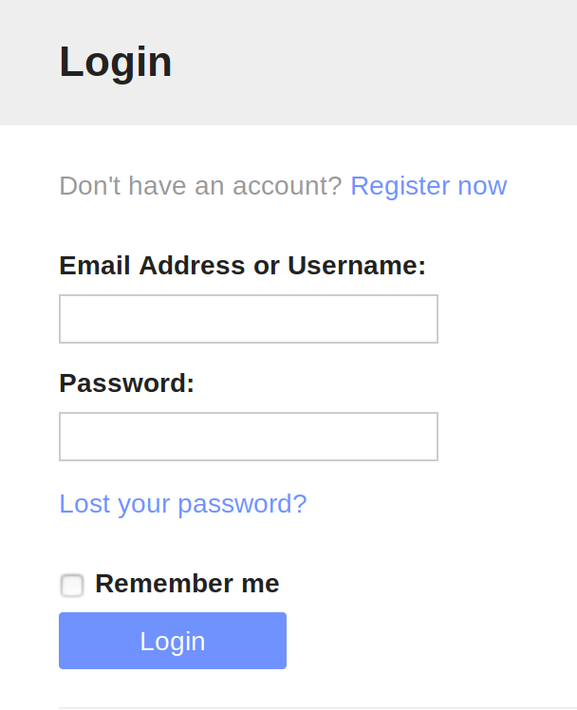
Creating an account

Slide 15
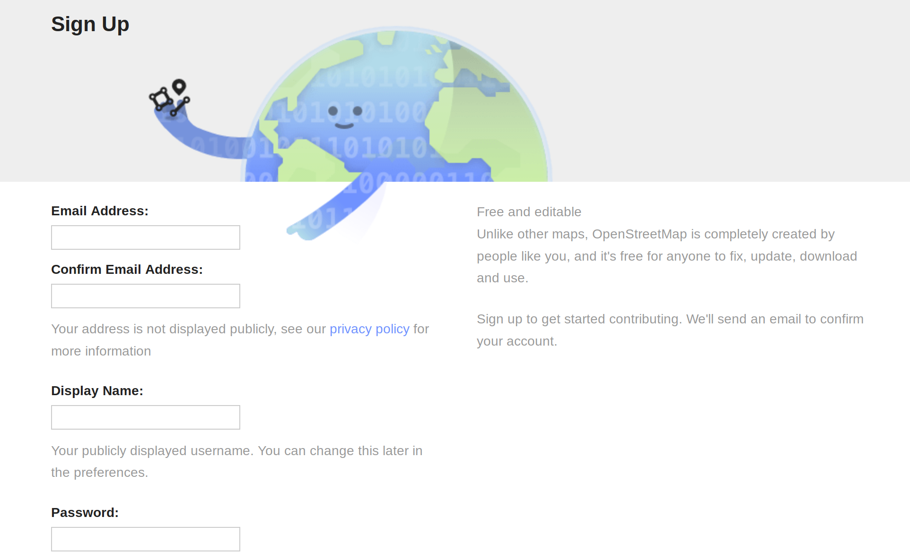
Creating an account

Slide 16
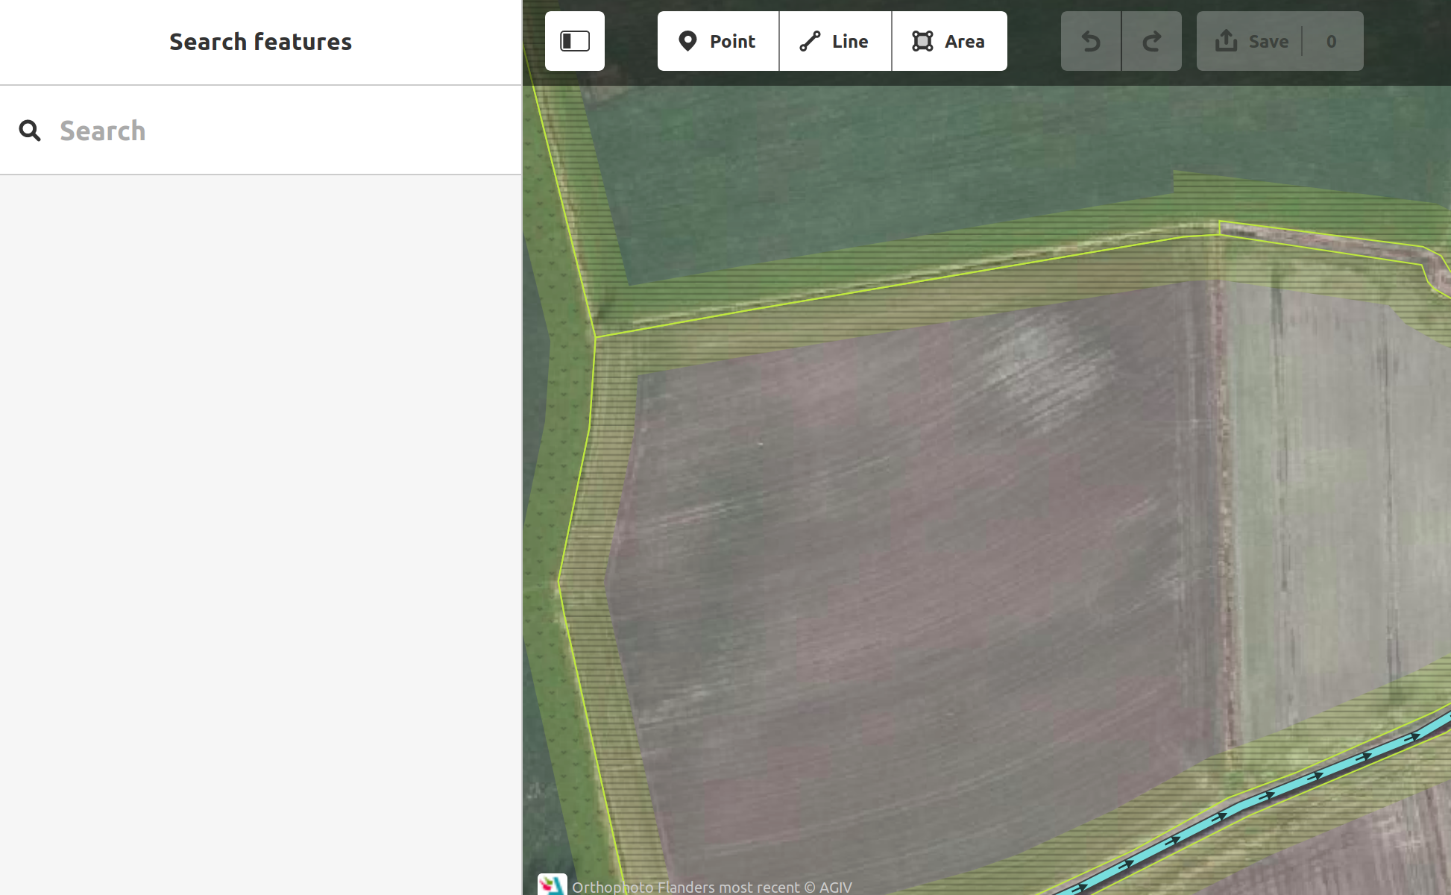
Creating an account

Slide 17
Adding a point

Slide 18
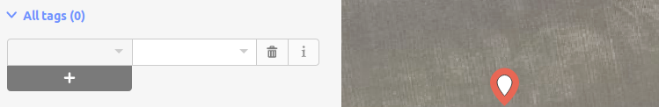
Adding a point

Slide 19
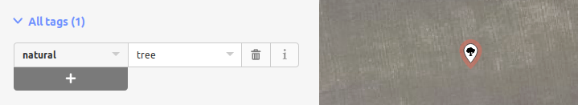
Adding a point

Slide 20
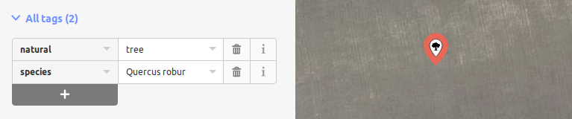
Adding a point

Slide 21

Adding a point
The property we are describing (Key)
The value of the property
(Value)

Slide 22
Euhm…
I don’t know any of those tags
A tremendous lot is known by the editor
Something special: have a look on wiki.osm.org
Ask the community (of the country where you are mapping)
Still no answer? Invent something, in collaboration with the community

Slide 23
Lines

Slide 24
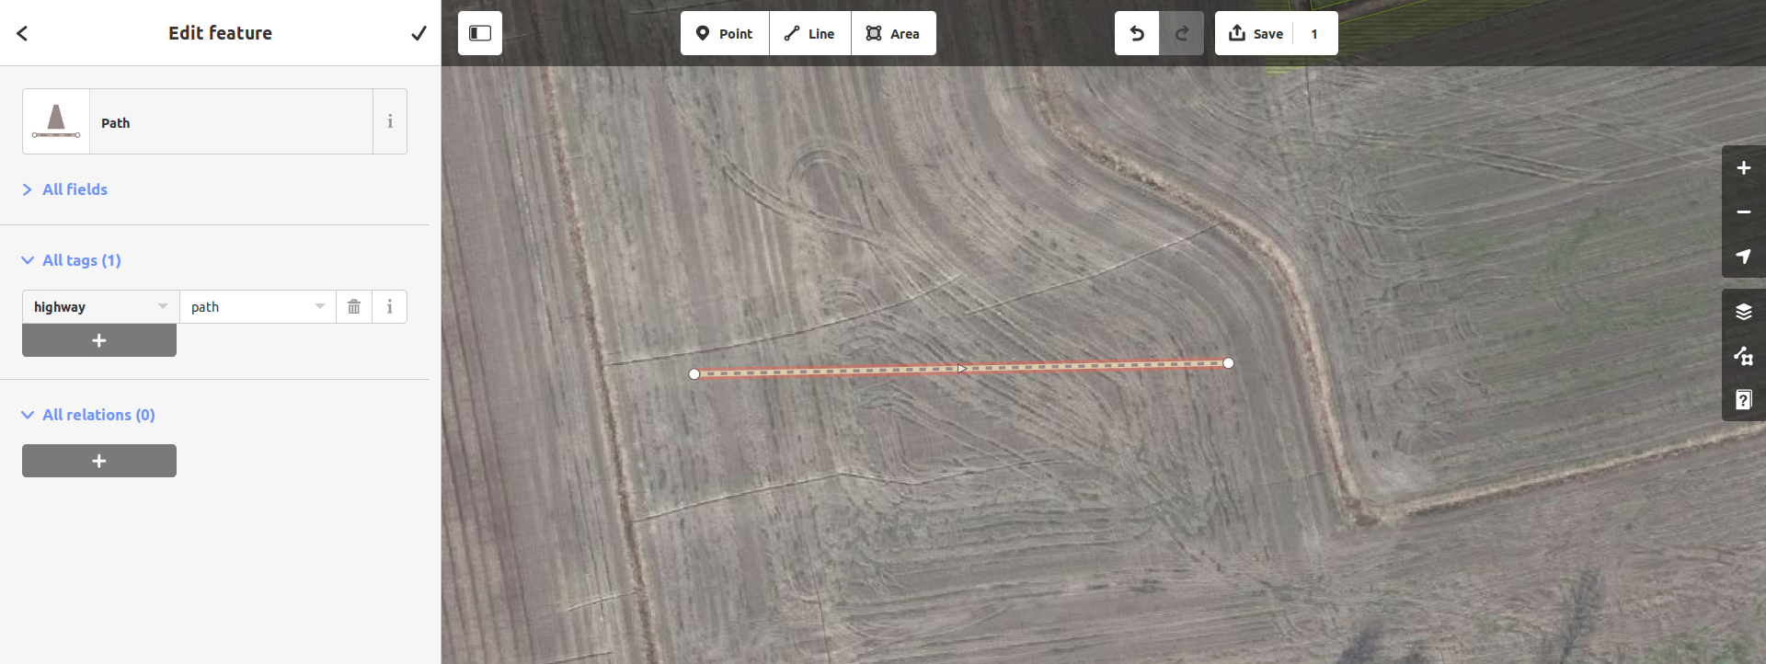
Lines

Slide 25
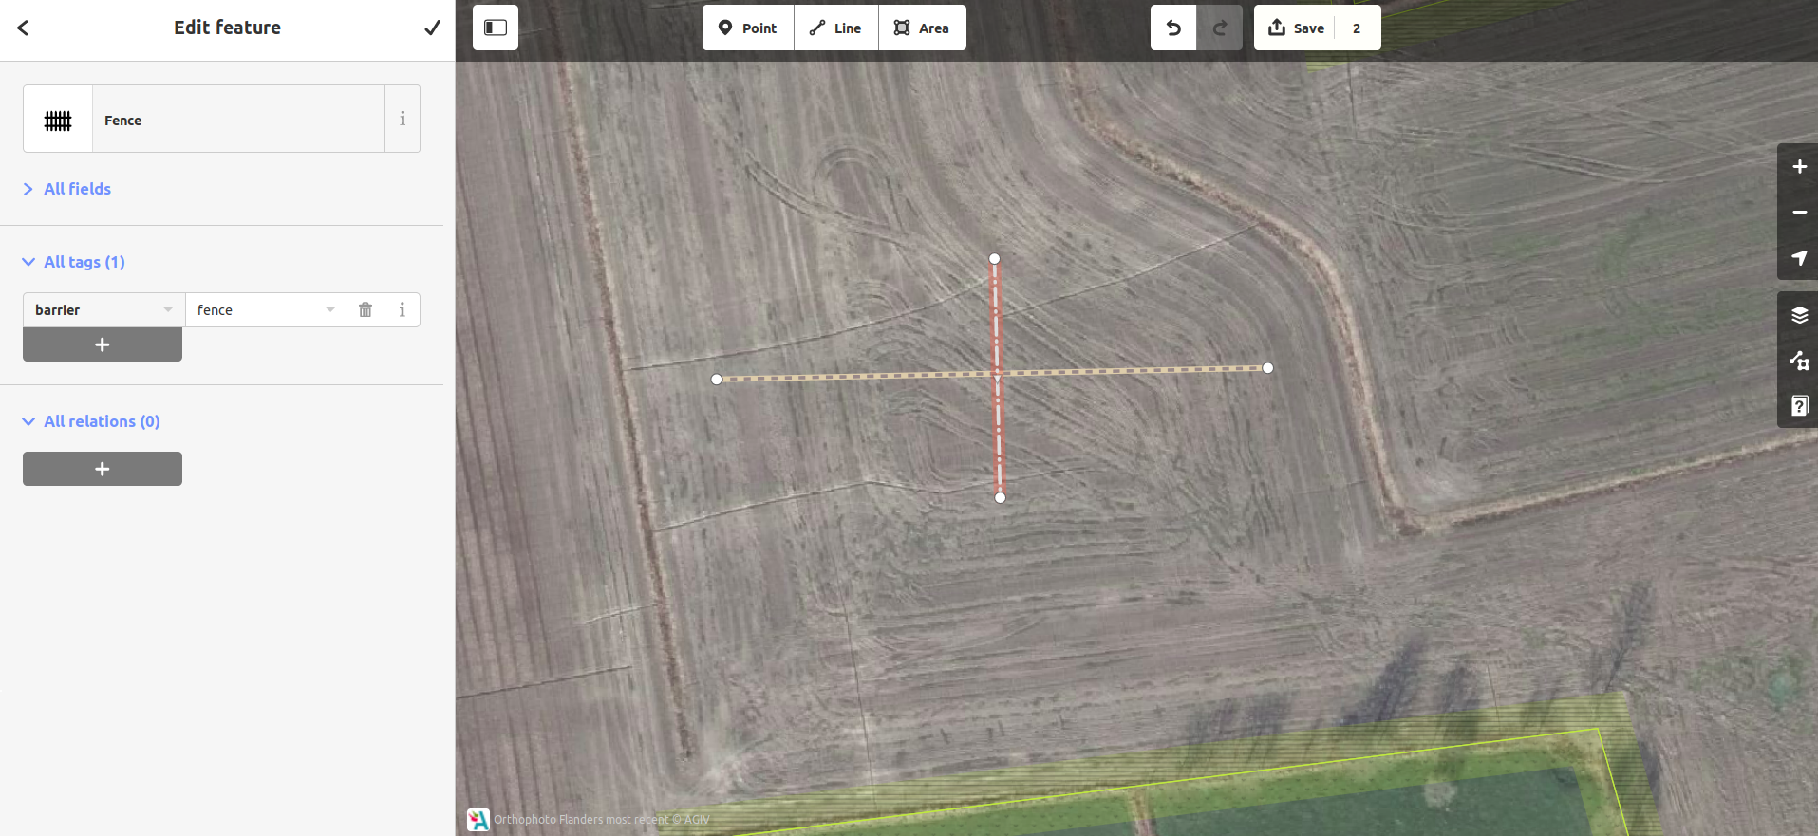
Lines

Slide 26
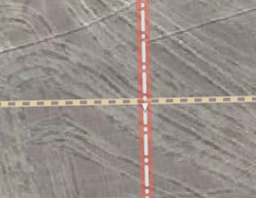
Lines

Slide 27
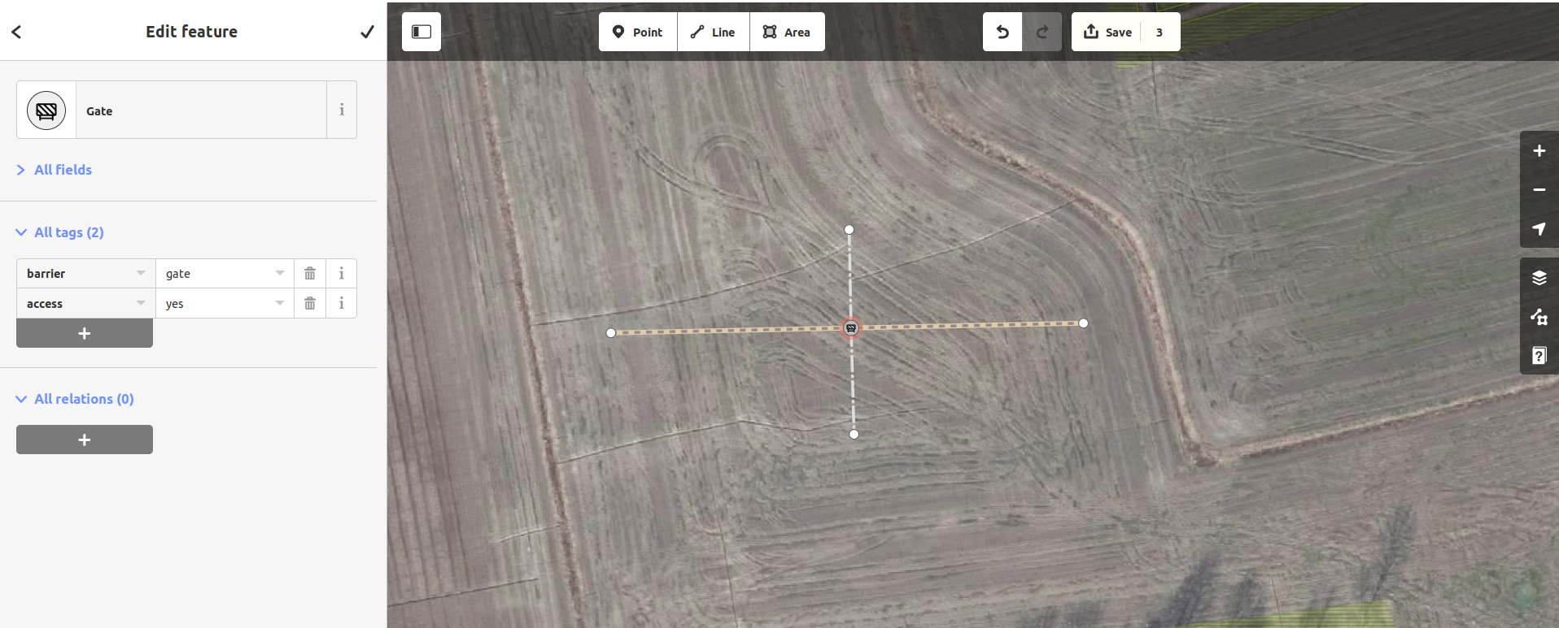
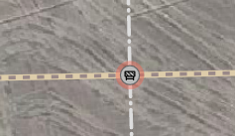
Lines

Slide 28
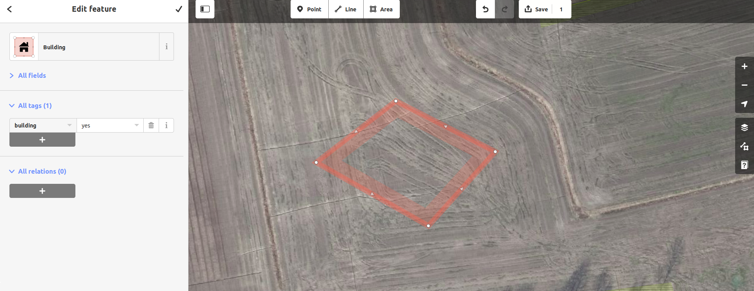
Areas

Slide 29
Areas

Slide 30
A little secret

Slide 31
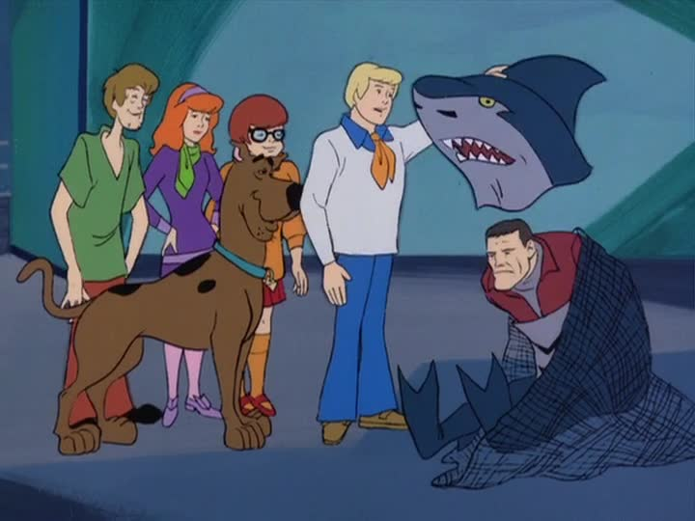
A little secret
© Hanna-Barbera

Slide 32
A little secret
They are just lines too!
But:
end = begin
© Hanna-Barbera

Slide 33
Your turn!

